Slide 1
Digital Image Processing

Slide 2
Digital Image Processing-
Processing of Images which are digital in nature by a digital computer

Slide 3
Principal application area
Improvement of pictorial information for human interpretation
Processing of image data for storage, transmission and representation for autonomous machine perception.

Slide 4
What is an Image?
A digital representation of a real-world scene. (Graphics is the digital representation of an imaginary scene.)
Composed of discrete elements generally called picture element (or pixels for short), pels, image elemments
Pixels are parameterized by
  position
  intensity
  time
In all combinations, these parameters define still images, video, volume data and moving volumes

Slide 5
Analog Vs Digital Image
An analog image is a continuous range of values representing position and intensity.
A digital image is composed of picture elements called pixels. A pixel represents brightness value at one point.
Conversion of analog to digital involves two process sampling and quantization.
Analog Image
Digital Image
Sampling
Quantization

Slide 6
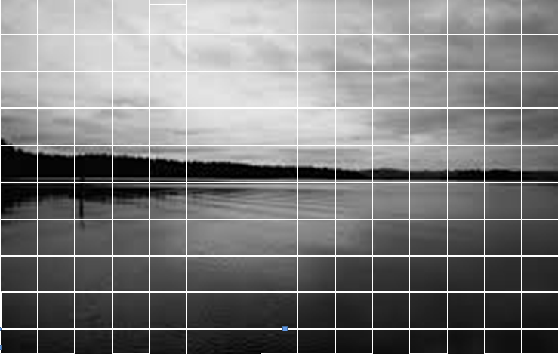
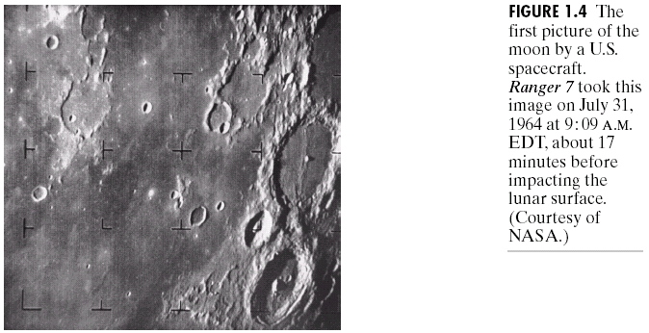
Analog Image Example

Slide 7
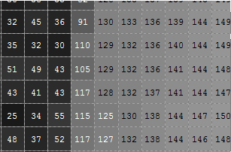
Digital Image (After Sampling & Quantization)

Slide 8
Advantage and Disadvantages of using Digital Image
Advantages:
The processing of an image is faster and cost effective
Can be stored, copied and transferred easily
Quality of an digital image does not degrade over a period of time.
Disadvantages:
Misuse of copyright
Cannot be enlarged without compromising quality
Memory required to store and process is relatively high.
May require high end processor depending on application.

Slide 9
Digital Image: Definition
An image may be defined as a two dimensional function, f(x, y) where x and y are spatial (plane) coordinates, and the amplitude values f at any pair of coordinates (x, y) is called the intensity or gray level of the image at that point.
When x, y and the amplitute values of f are all finite, discrete quantities an image is called digital image

Slide 10
Different Kinds of Images

Slide 11
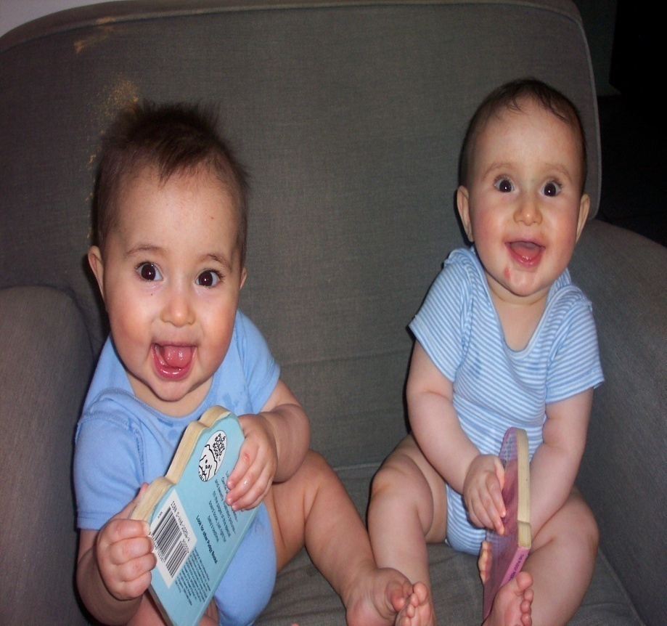
Digital Photographs
Two spatial parameters
  x or horizontal position
  y or vertical position
Three intensity parameters
  Red
  Green
  Blue

Slide 12
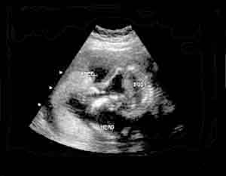
Ultrasound
Two spatial parameters – x and y
One intensity parameter – ultrasound reflection
One time parameter (ultrasound printouts don’t show this, but the exam does)

Slide 13
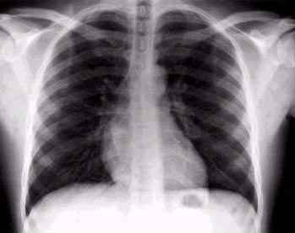
Digital X-ray
Two spatial parameters – x and y
A single intensity parameter
– x-ray attenuation

Slide 14

Digital Video
Two spatial parameters
  x, or horizontal position
  y, or vertical position
Three intensity parameters
  Red
  Green
  Blue
One time parameter
– frame

Slide 15
Other Kinds of Images
Human are limited to the visual band of electromagnetic (EM) spectrum, but image machines covers almost entire EM spectrum, ranging from gamma to radio waves.
Computed Tomography – 3 dimensional x-ray images of the human body
Satellite images – 4 intensities – red, green, blue and infrared
Functional Magnetic Resonance Images – 3 dimensional images of the human body over time

Slide 16
What is digital image processing?
Digital image processing encompasses process whose inputs and outputs are images and in addition, encompasses processes that extract attributes from images, up to and including recognition of individual objects.

Slide 17
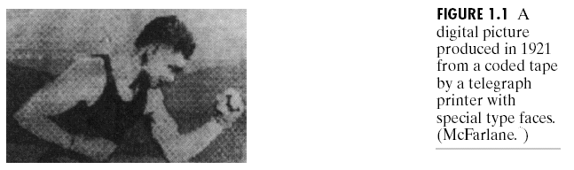
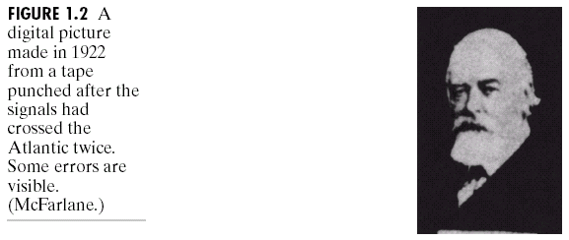
Initial Examples of Imagery

Slide 18
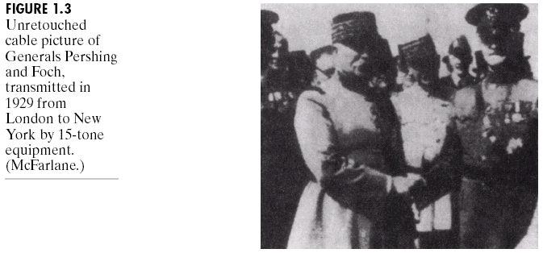
Improvement

Slide 19
Digital Image Processing

Slide 20
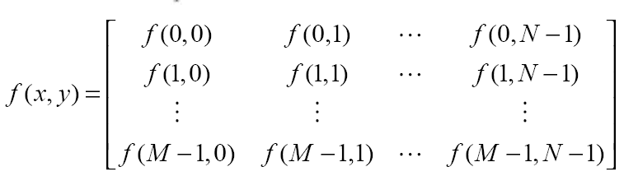
Image Representation
An image f(x,y) of size MXN in matrix form:
Each elements of this matrix called am image elements, pixels.
Generally, Image Size are: 256x256, 512x512, 1024x1024, etc.
Quantization: 8 bit (256 different values) or 24 bit for color Image.

Slide 21
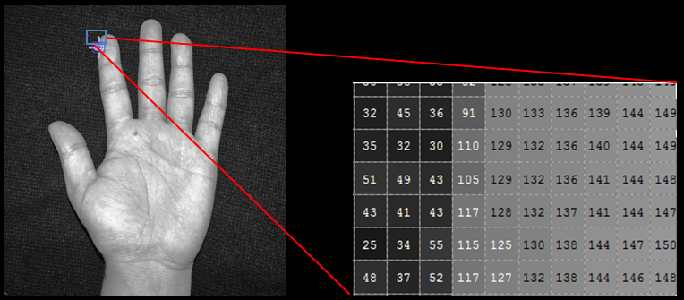

Slide 22
Fundamental Steps in
Digital Image Processing

Slide 23
Important Stages in Image Processing
Image Acquisition
Image Enhancement
Image Restoration
Color image processing
Wavelets
Compression
Morphological processing
Segmentation
Representation and Description
Recognition and Interpretation
Knowledge base

Slide 24
Image Acquisition
Image acquisition refers to the process of capturing real world images and storing them in computer.
Imaging sensor has capability to digitize the signal collected by the sensor
  Video camera
  Digital camera
  Conventional camera & analog-to-digital converter

Slide 25


Key Stages in Digital Image Processing:
Image Aquisition
Image Restoration
Morphological Processing
Image Enhancement
Segmentation
Image Acquisition
Representation & Description
Images taken from Gonzalez & Woods, Digital Image Processing (2002)
Object Recognition
Problem Domain
Colour Image Processing
Image Compression

Slide 26
Image Enhancement
It is the process of manipulating an image so that the result is more suitable than the original for specific applications.
To bring out the detail that is obscured, or simply to highlight certain feature of interest in an image.
e.g. enhancing contrast
removing noise
identifying information-rich areas
More subjective in nature.

Slide 27

Key Stages in Digital Image Processing:
Image Enhancement
Image Restoration
Morphological Processing
Image Enhancement
Segmentation
Image Acquisition
Representation & Description
Images taken from Gonzalez & Woods, Digital Image Processing (2002)
Object Recognition
Problem Domain
Colour Image Processing
Image Compression

Slide 28
Image Restoration
To improve the appearance of an image.
More objective in nature.
Restoration techniques are based on mathematical or probabilistic models of image degradation.

Slide 29
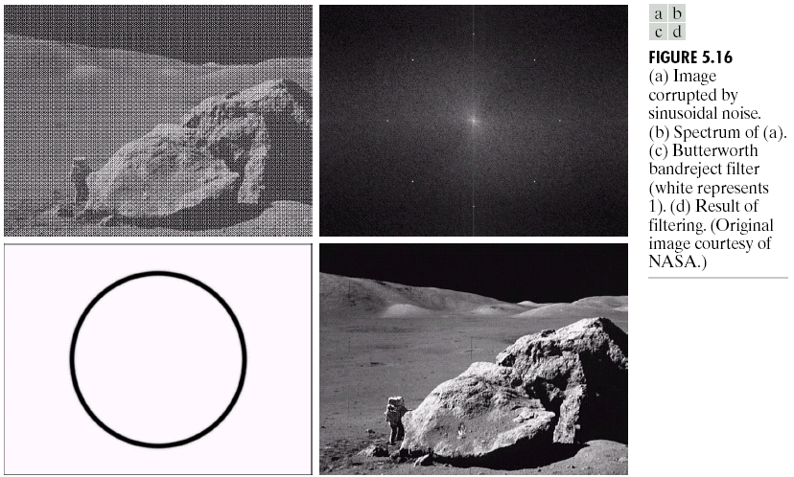
Key Stages in Digital Image Processing:
Image Restoration
Image Restoration
Morphological Processing
Image Enhancement
Segmentation
Image Acquisition
Representation & Description
Images taken from Gonzalez & Woods, Digital Image Processing (2002)
Object Recognition
Problem Domain
Colour Image Processing
Wavelets
Image Compression

Slide 30
Color image Processing
Full-color processing:
images are acquired with full color sensors, such as color TV camera or color scanner.
Pseudo color Processing:
It deals with assigning a color to a particular monochrome intensity or range of intensity

Slide 31
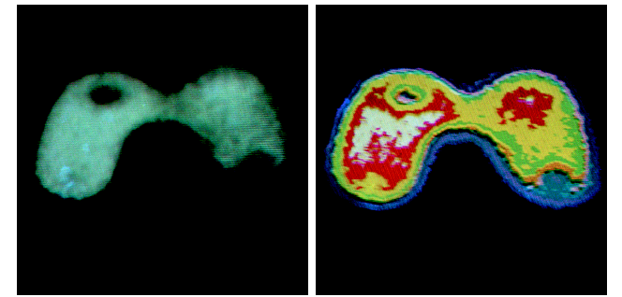
Key Stages in Digital Image Processing:
Colour Image Processing
Image Restoration
Morphological Processing
Image Enhancement
Segmentation
Image Acquisition
Representation & Description
Object Recognition
Problem Domain
Colour Image Processing
Wavelets
Image Compression

Slide 32
Wavelets
It represents an image in various degree of resolution.
Used for data compression and for pyramidal representation, in which image are subdivided successively into smaller regions

Slide 33
Compression
It deals with techniques for reducing the storage required to save an image, or the bandwidth required to transmit it.
E.g. JPEG (Joint Photographic Experts Group) image compression standard.

Slide 34
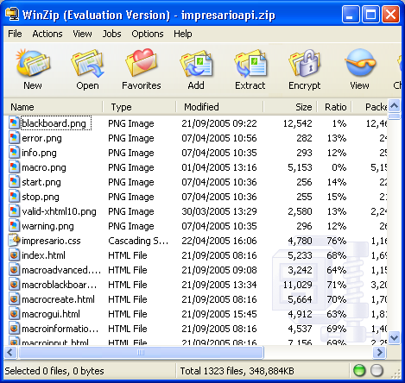
Key Stages in Digital Image Processing:
Image Compression
Image Restoration
Morphological Processing
Image Enhancement
Segmentation
Image Acquisition
Object Recognition
Representation & Description
Problem Domain
Colour Image Processing
Image Compression

Slide 35
Morphological processing
It deals with tools for extracting image components that are useful in representation and description of shape e.g. boundaries, skeletons, and the convex hull.

Slide 36
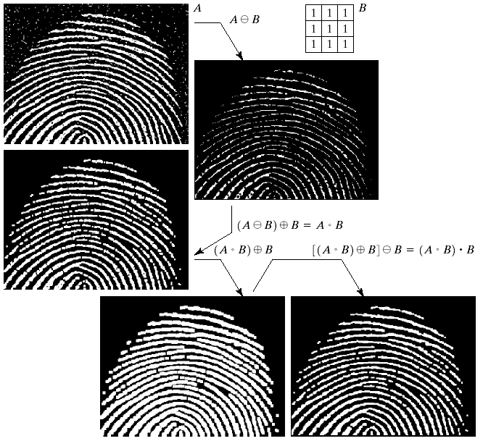
Key Stages in Digital Image Processing:
Morphological Processing
Image Restoration
Morphological Processing
Image Enhancement
Segmentation
Image Acquisition
Object Recognition
Images taken from Gonzalez & Woods, Digital Image Processing (2002)
Representation & Description
Problem Domain
Colour Image Processing
Image Compression

Slide 37
Segmentation
To partition the image into its constituent parts (objects)
  Output
  Representation:
    Raw pixel data, depicting either boundaries or whole regions (corners vs. texture for example)
    Need conversion to a form suitable for computer processing
  Description: feature extracted

Slide 38
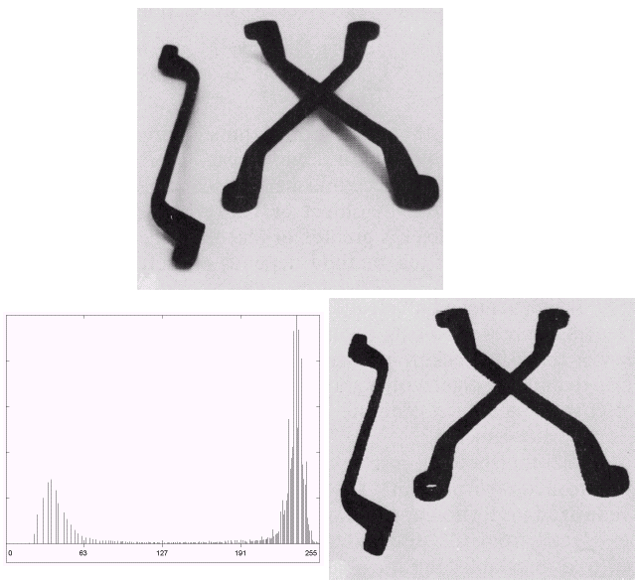
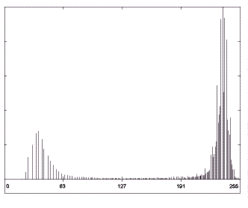
Key Stages in Digital Image Processing:
Segmentation
Image Restoration
Morphological Processing
Image Enhancement
Segmentation
Image Acquisition
Representation & Description
Images taken from Gonzalez & Woods, Digital Image Processing (2002)
Object Recognition
Problem Domain
Colour Image Processing
Image Compression

Slide 39
Representation
Boundary representation:
focuses on external shape characteristics, such as corners and inflections
Regional representation:
focuses on internal properties, such as texture or skeletal shape.

Slide 40
Description
Feature selection (description) deals with extracting:
  features that result in quantitative information of interest
  or
  features that are important for differentiating one class of objects from another

Slide 41
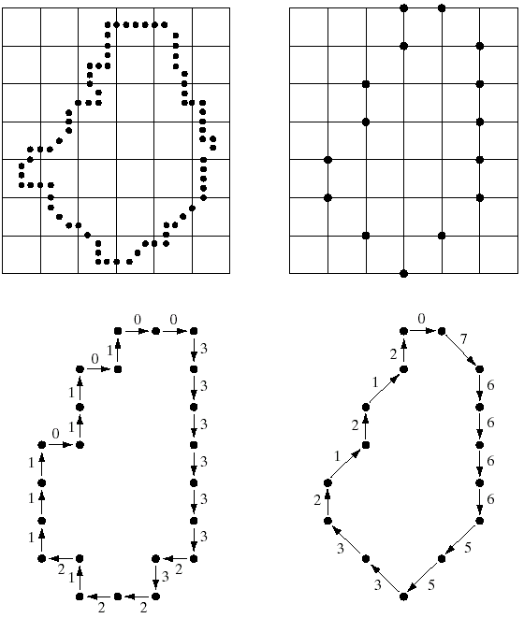
Key Stages in Digital Image Processing:
Representation & Description
Image Restoration
Morphological Processing
Image Enhancement
Segmentation
Image Acquisition
Images taken from Gonzalez & Woods, Digital Image Processing (2002)
Representation & Description
Problem Domain
Object Recognition
Colour Image Processing
Image Compression

Slide 42
Recognition & Interpretation
To assign a label to an object based on information provided by the descriptors
To assign meaning to a group of recognized objects

Slide 43
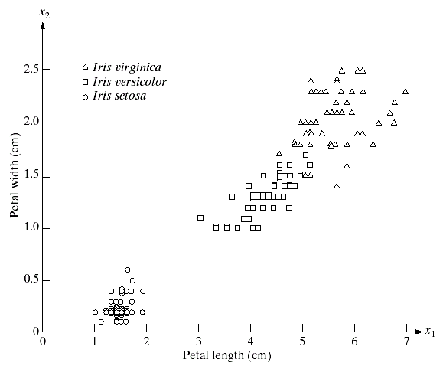
Key Stages in Digital Image Processing:
Object Recognition
Image Restoration
Morphological Processing
Image Enhancement
Segmentation
Image Acquisition
Images taken from Gonzalez & Woods, Digital Image Processing (2002)
Representation & Description
Problem Domain
Object Recognition
Colour Image Processing
Image Compression

Slide 44
Knowledge Base
Knowledge about a problem domain is coded into an image processing system in form of database.
Knowledge database
  Guides the operation of each processing module and controls the interaction between modules

Slide 45
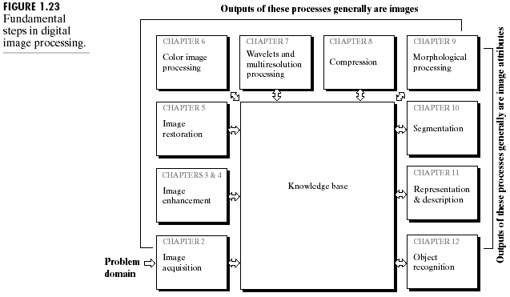

Slide 46
Digital image processing: levels of computerized process
Low-level processing includes image preprocessing, contrast enhancement, image sharpening. Both input and output are images.
Mid –Level processing involves segmentation description and classification of individuals objects. Input are images but outputs are attributes extracted from those images (e.g. edges, contours etc.)
Higher- level processing involves “making sense” of an ensemble of recognized objects as in image analysis.

Slide 47
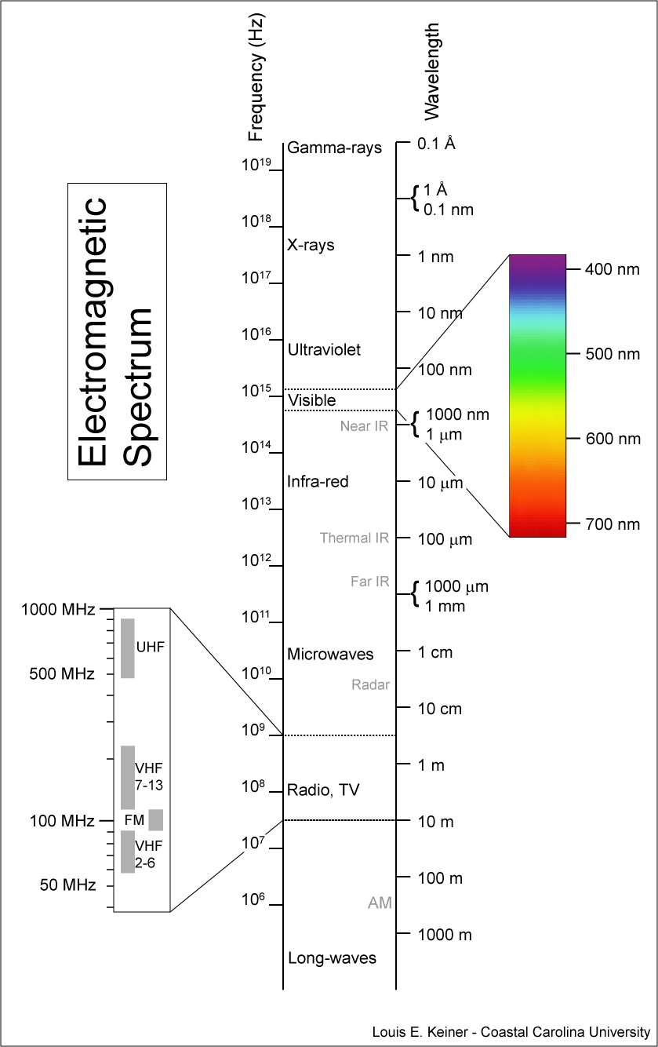
Image: Energy source
Electromagnetic (EM) Spectrum-
  propagating sinusoidal waves of varying wavelengths
  stream of mass less particles, each traveling in wavelike pattern.
  these mass less particle contains certain amount of energy called photons
  Spectrals bands are grouped according to energy per photons.
Other source – Acoustic, Ultasonic, and electronic energy

Slide 48
Image Processing (contd..)
Image processing typically attempts to accomplish one of three things
  restoring images
  enhancing images
  understanding images
Restoration takes a corrupted image and attempts to recreate a clean original
Enhancement alters an image to makes its meaning clearer to human observers
Understanding usually attempts to mimic the human visual system in extracting meaning from an image

Slide 49
Image Restoration
Image restoration is important for two main applications
  removing sensor noise
  restoring old, archived film and images
Many sensors are subject to noise, thus producing corrupted images that don’t reflect the real world scene accurately
Old photograph and film archives often show considerable damage

Slide 50
Restoration Example
Images from Digital Image Processing, Gonzalez and Woods

Slide 51
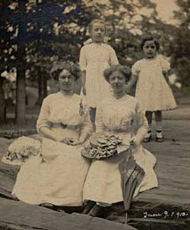
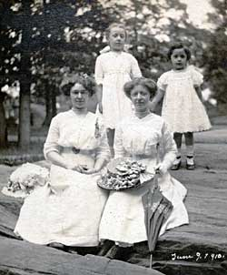
Restoration Example
Images from http://www.screengenes.com/drest_3.html

Slide 52
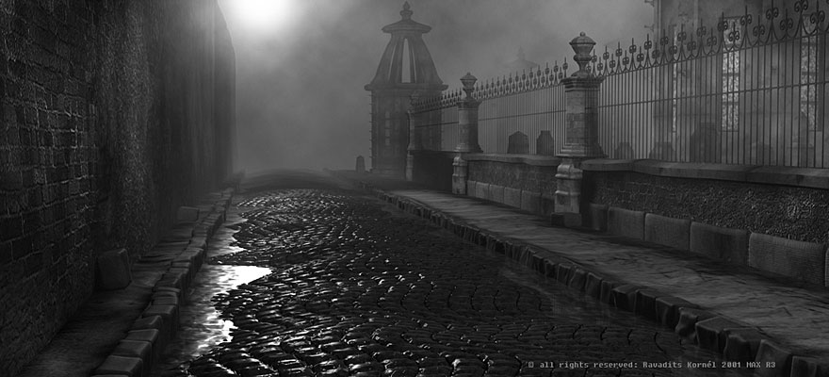
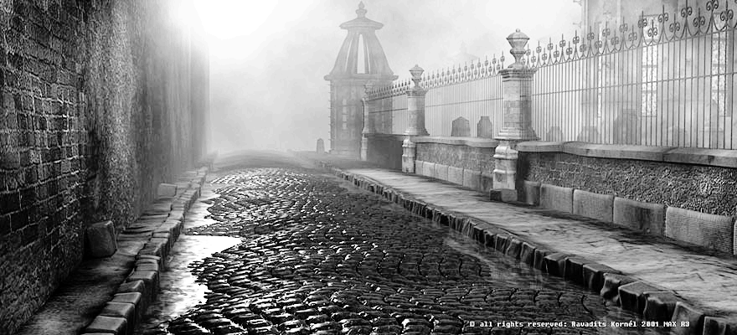
Image Enhancement
Images courtesy of Tobey Thorn
Often used to increase the contrast in images that are overly dark or light
Enhancement algorithms often play to humans’ sensitivity to contrast
More sophisticated algorithms enhance images in a small neighborhood, allowing overall better enhancement.

Slide 53
Image Understanding
Image understanding includes many different tasks
  segmentation
  classification
  interpretation
Segmentation involves identifying objects in an image
Classification assigns labels to individual pixels
Interpretation extracts some meaning from the image as a whole
Leads to such fields as image analysis, computer vision and visual computing

Slide 54
Creating Images
The creation of images involves two main tasks
  spatial sampling, which determines the resolution of an image
  quantization, which determines how many intensity levels are allowed
Spatial sampling determines what level of detail can be seen
  finer sampling allows for smaller detail
  finer sampling requires more pixels and “larger” images
Quantization determines how “smooth” the contrast changes in the image are
  finer quantization will prevent “false contouring” (artificial edges)
  courser quantization allows for compressing images

Slide 55
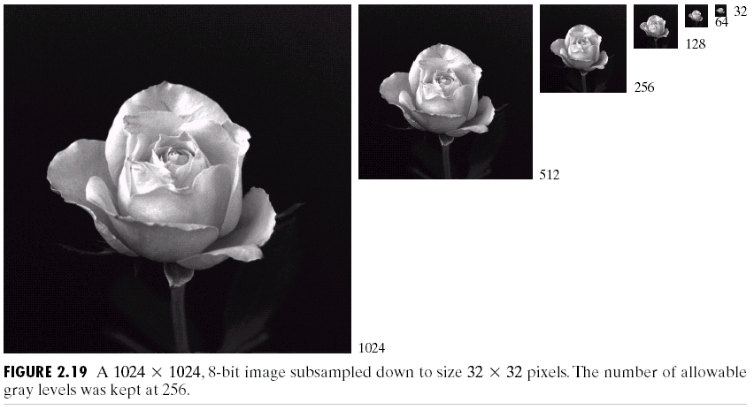
Effect of Spatial Sampling

Slide 56
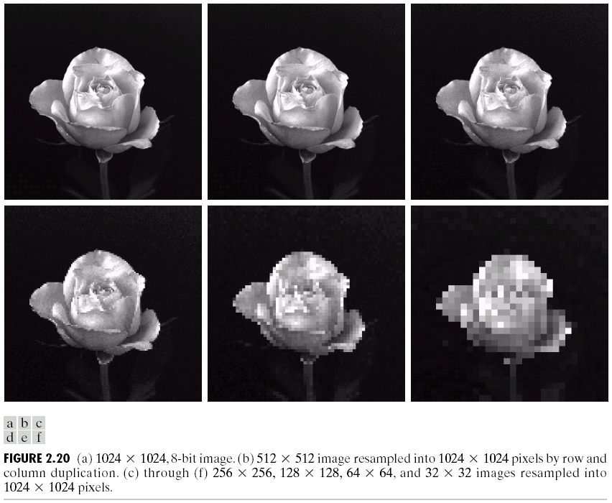
Effect of Spatial Sampling

Slide 57
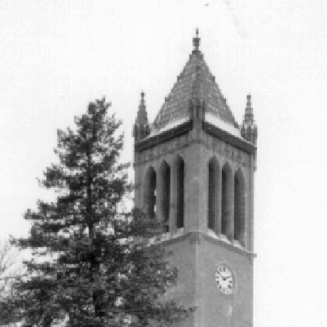


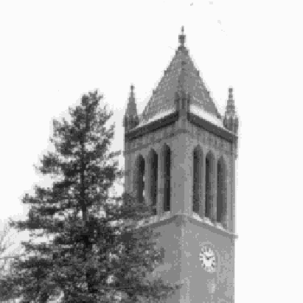
Effect of Quantization

Slide 58

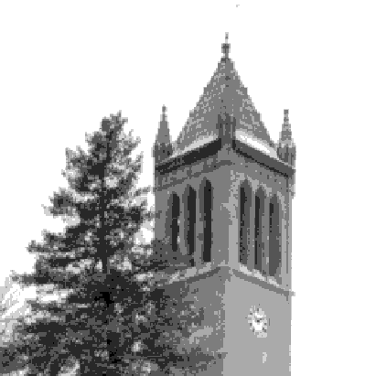
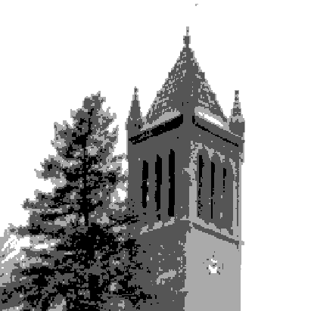

Effect of Quantization

Slide 59
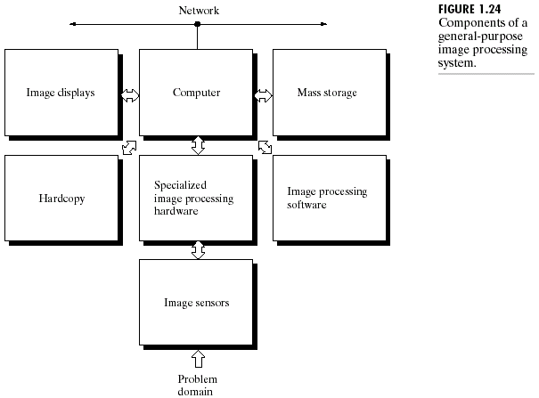
Components

Slide 60
Components of an image Processing system
Image sensors:
Two elements are required to acquire digital images
- Device sensitive to the energy radiated by the object we wish to image. (sensors)
- Device for converting the output of the physical sensing device into digital from. (digitizers)
For e.g. In digital video camera, the sensors produce an electrical output proportional to light intensity and digitizer converts these outputs to digital data.

Slide 61
Components of an image Processing system (contd..)
Specialized image processing hardware:
- It consists of the digitizers and hardware that performs other primitive operations, such as ALU, which performs arithmetic and logical operations in parallel on entire images.
eg. Averaging an digital image for the purpose of noise reduction.
- this hardware is also called a front end subsystem, this unit performs functions that require fast data throughputs (e.g. digitizing and averaging video images at 30 frames/s)

Slide 62
Components of an image Processing system (contd..)
Computer:
- general purpose computer that can range from well equipped PC to supercomputer.
- for dedicated applications, specially designed computer are used to achieve a required level of performance

Slide 63
Components of an image Processing system (contd..)
Software:
- it consists of specialized modules that performs specific task.
- A well designed package also includes the capability for the user to write code as minimum as possible.
- More sophisticated software package allows integration of those modules and general purpose software commands from at least one computer language.

Slide 64
Components of an image Processing system (contd..)
Mass Storage:
Digital storage for image processing application falls into three principal categories:
- Short term storage for use during processing
Computer Memory or frame buffers
- online storage for relatively fast recall
Magnetic disks or optical media storage
- Archival storage, characterized by infrequent access.
Magnetic tapes or optical disk

Slide 65
Components of an image Processing system (contd..)
Image Display:
- Image display in use today are mainly color monitors
- Monitors are driven by the output of image and graphics display cards.
- for some applications, stereo display is necessary, these displays are implemented in the form of headgear containing two small displays embedded in goggles worn by user.

Slide 66
Components of an image Processing system (contd..)
Hardcopy
it includes:
- laser printers
- film cameras
- heat –sensitive devices
- inkjet units
- digital units
- optical and CD ROM disks.
- image projection equipments

Slide 67
Components of an image Processing system (contd..)
Networking:
- because of the large amount of data inherent in image processing applications, key consideration in image transmission is bandwidth.
- communications with remote sites via the internet are not always efficient.
- Optical fibers and other broadband technologies are already in use to improve transmission

